Slide 1
Jka Soccer Solutions logo & Pics
Joseph Kolawole abon

Slide 2
SOCCER COACHING EDUCATION CONNECTIONS
OHIO UNIVERSITY COACHING EDUCATION
https://youtu.be/o7ISMpwFkec?si=Goawp9BG4x9s-4zO
https://youtu.be/o7ISMpwFkec?si=HimDNfmSpSonwJ29

Slide 3
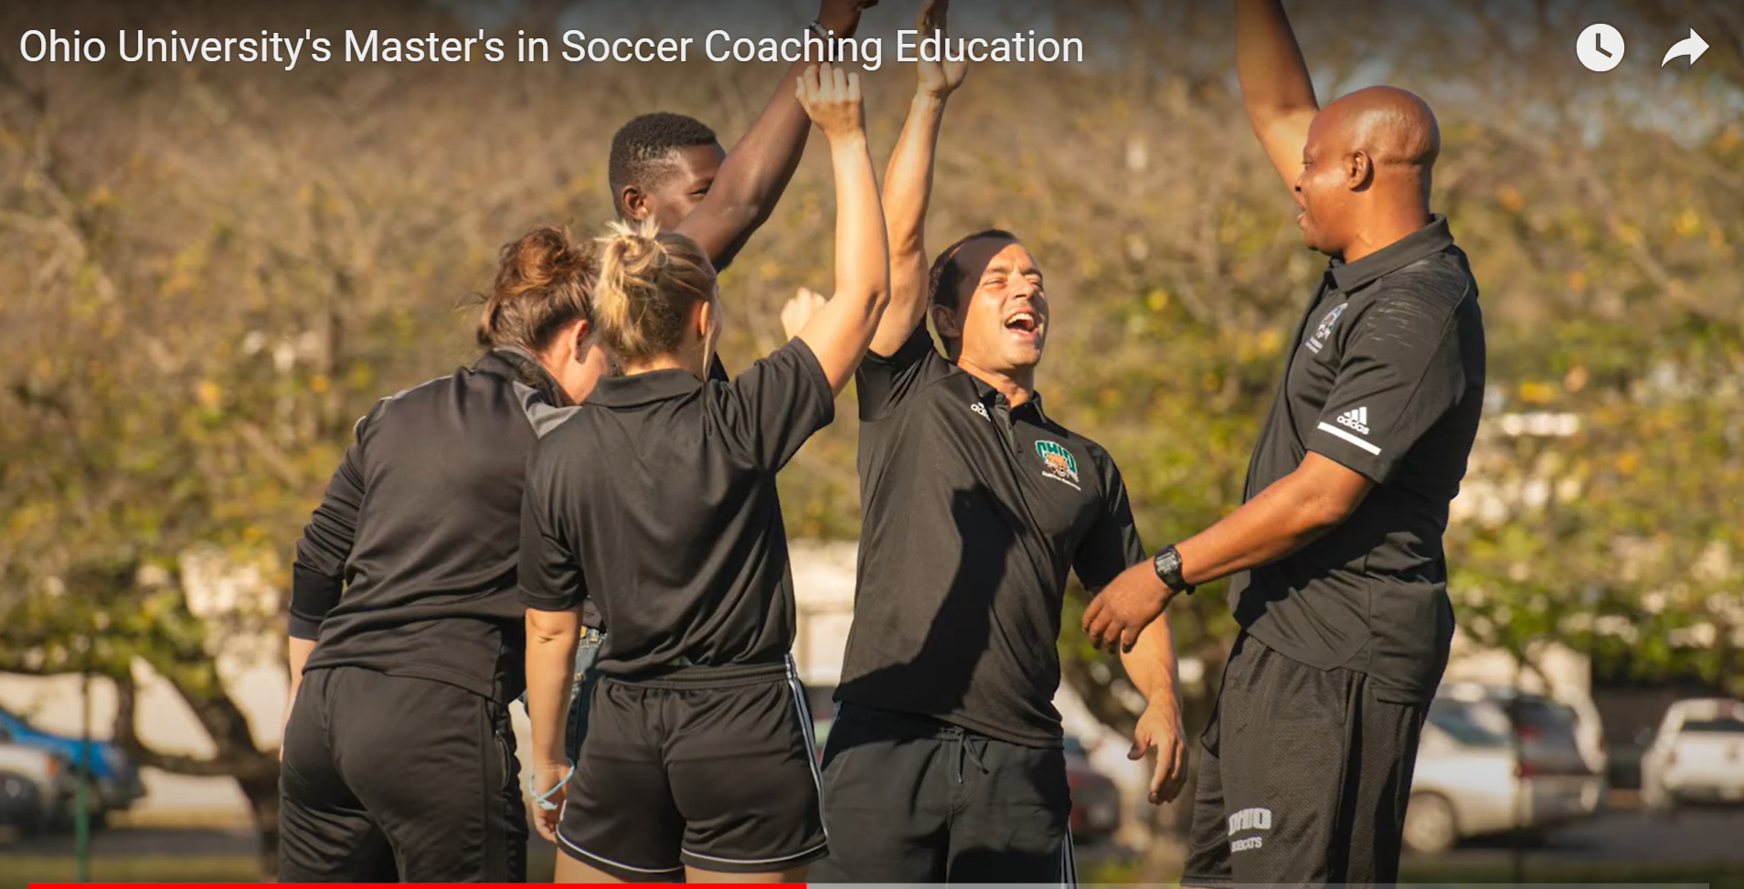
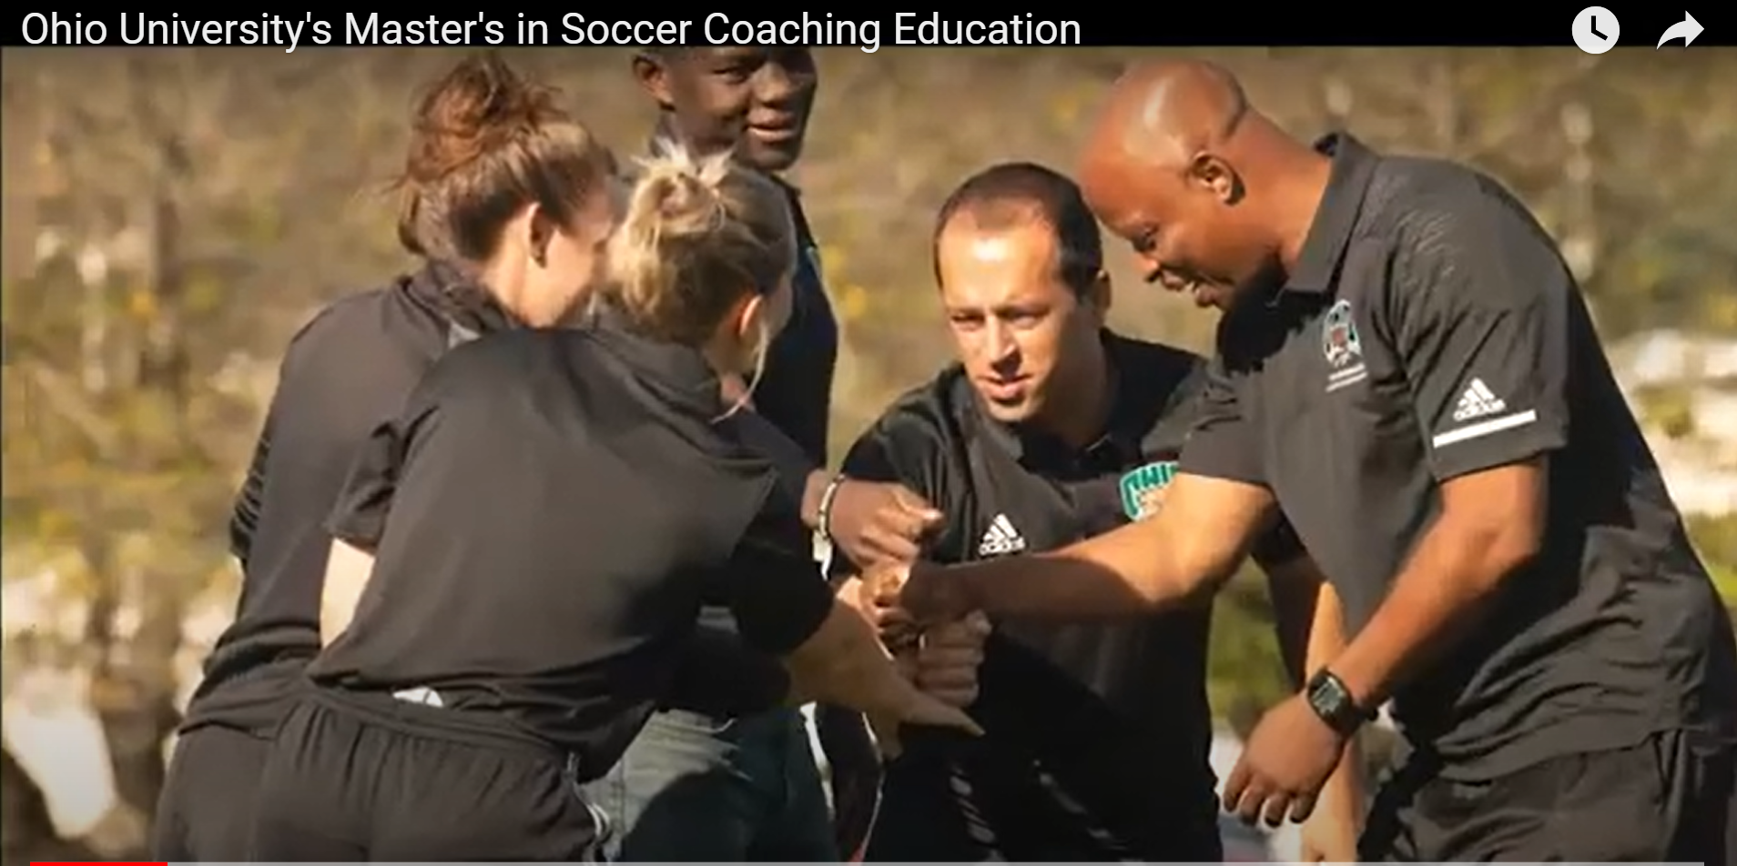
Ohio University's Master's in Soccer Coaching Education

Slide 4
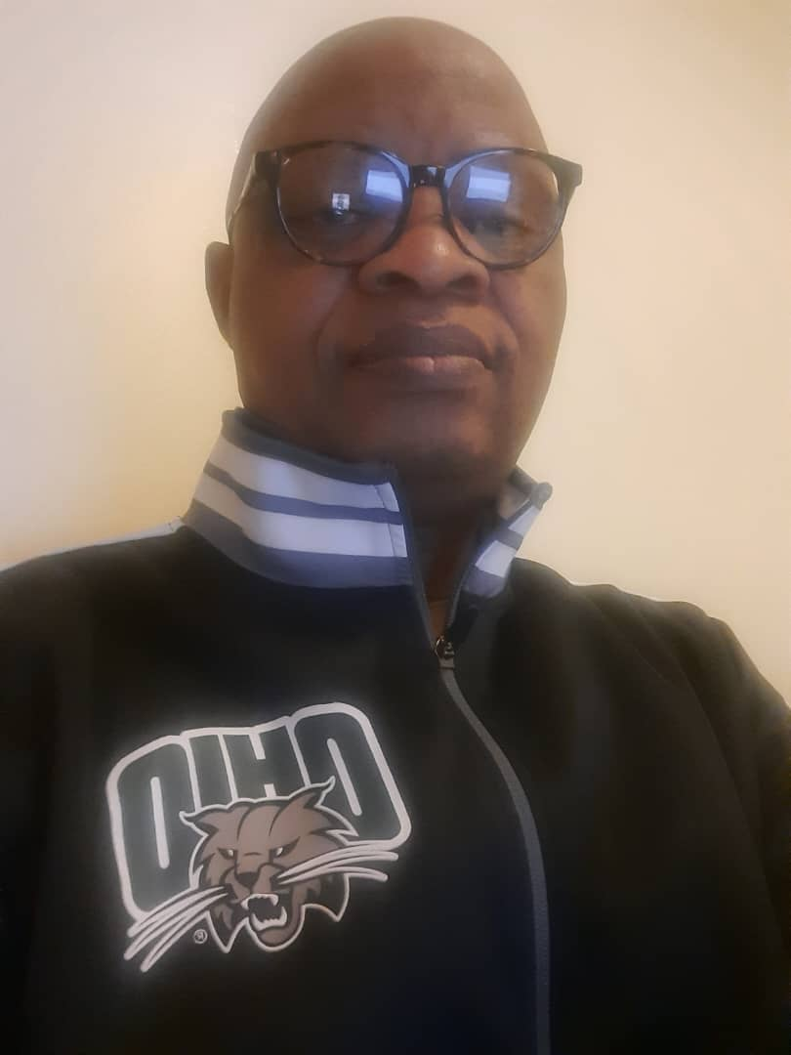




Soccer
Solutions
JKA SOCCER SOLUTIONS.COM

Slide 5
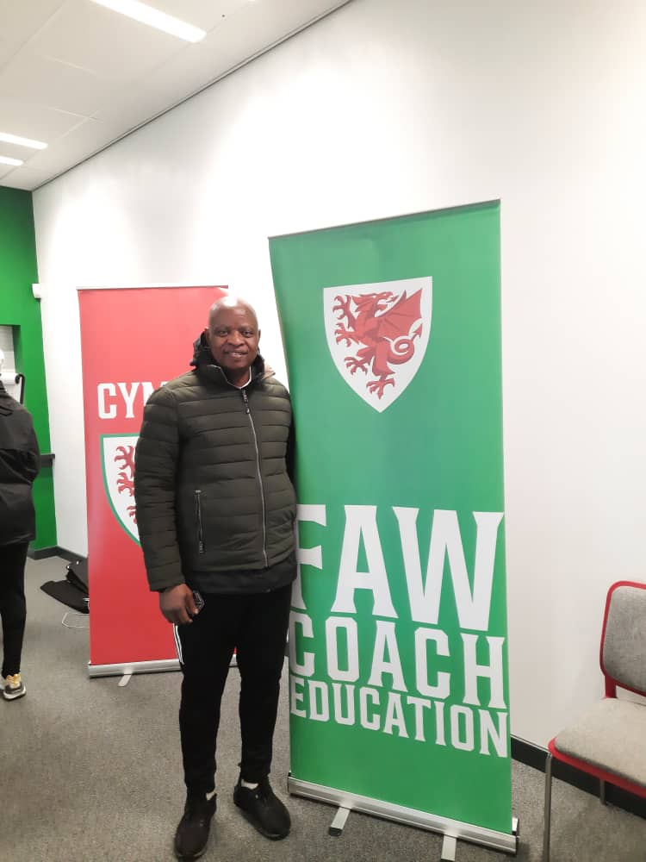
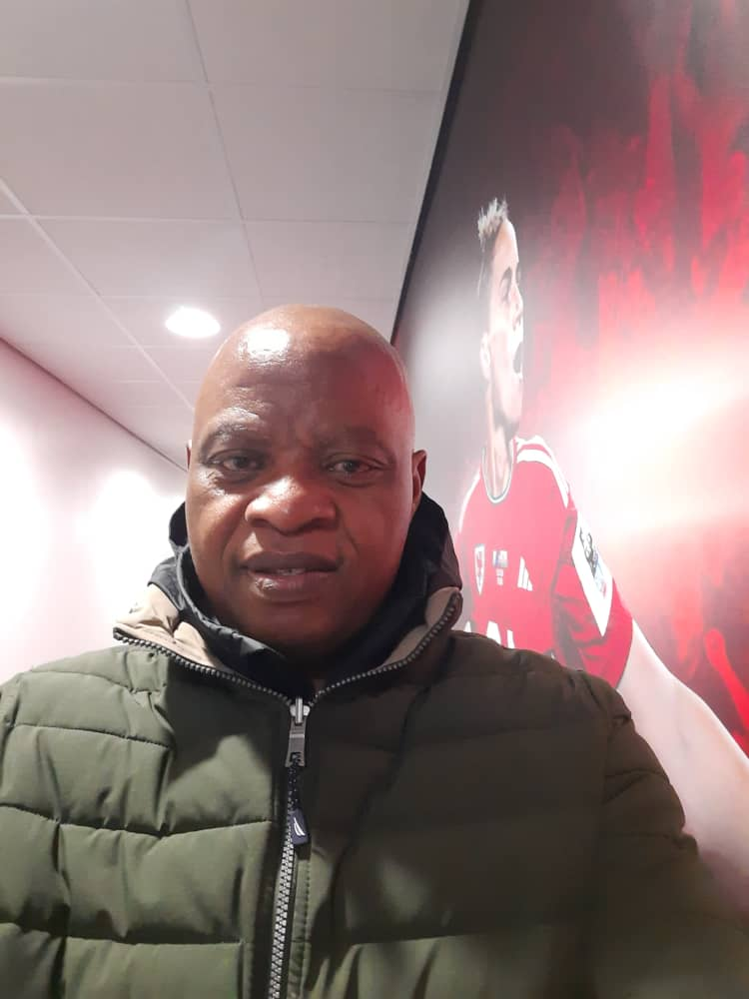
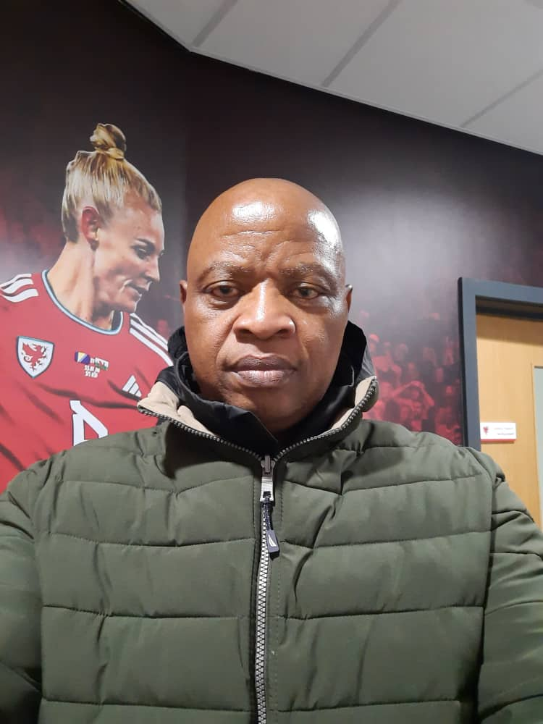

Slide 6




Slide 7
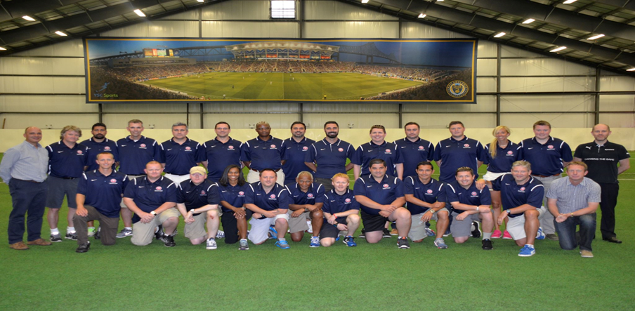

Slide 8
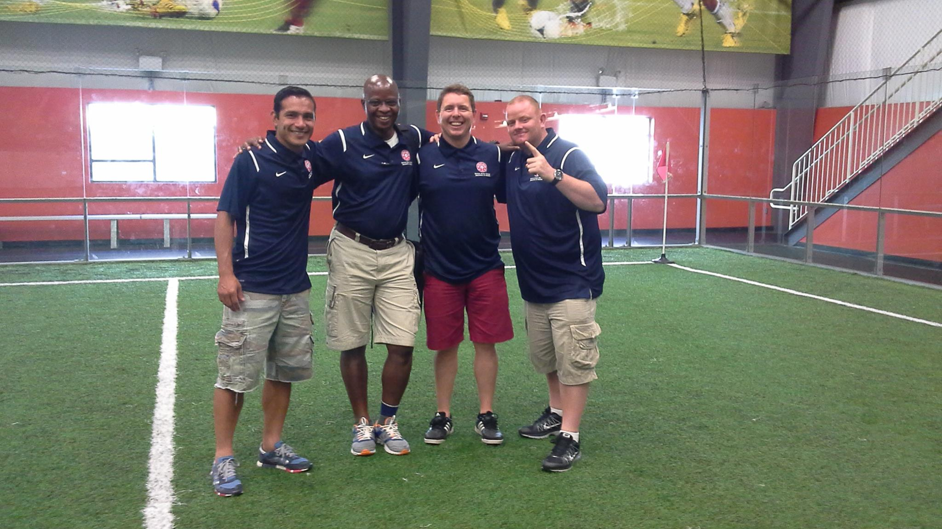

Slide 9
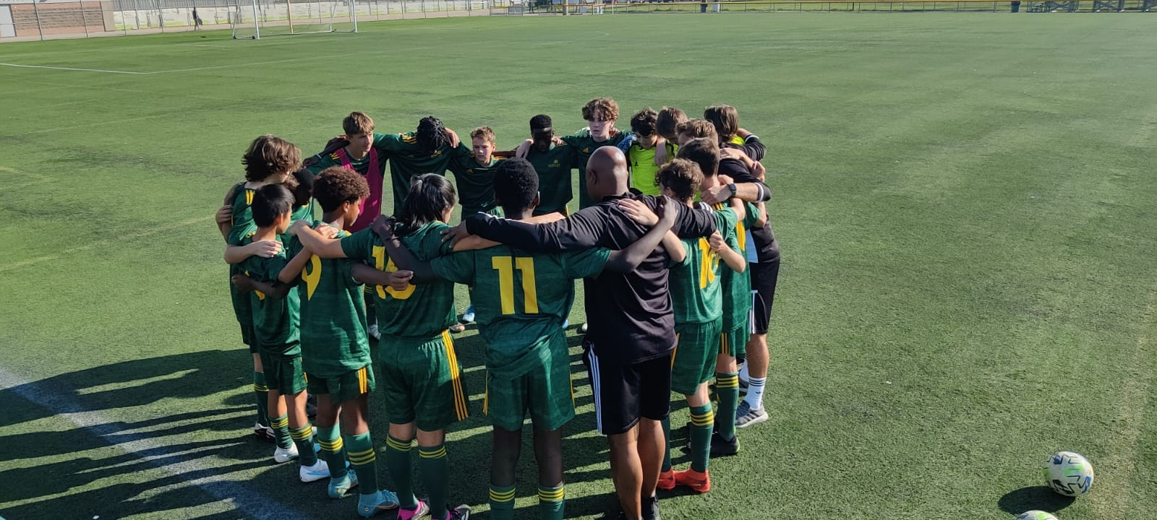

Slide 10
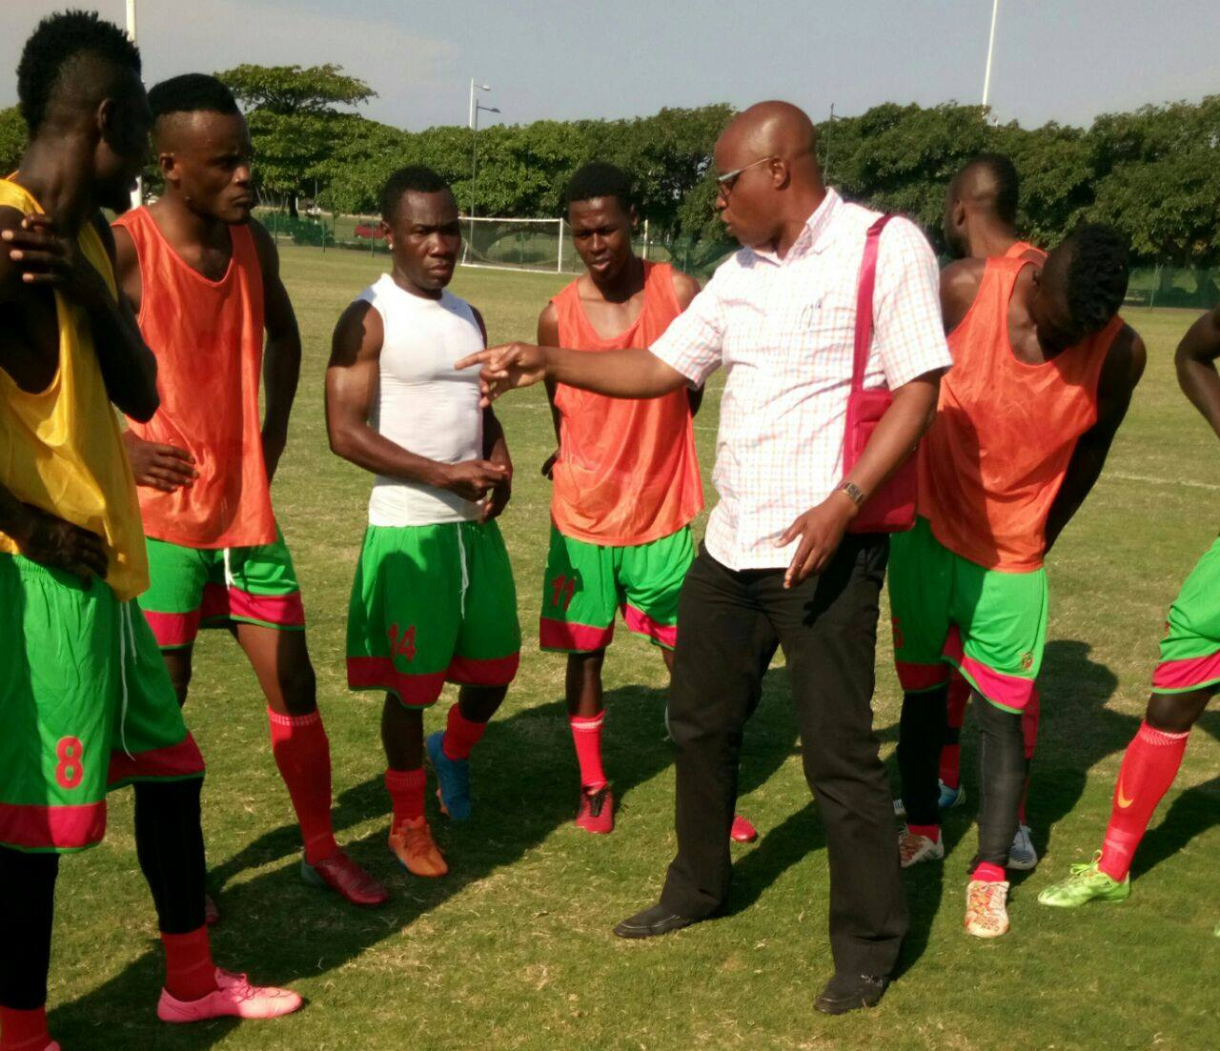

Slide 11
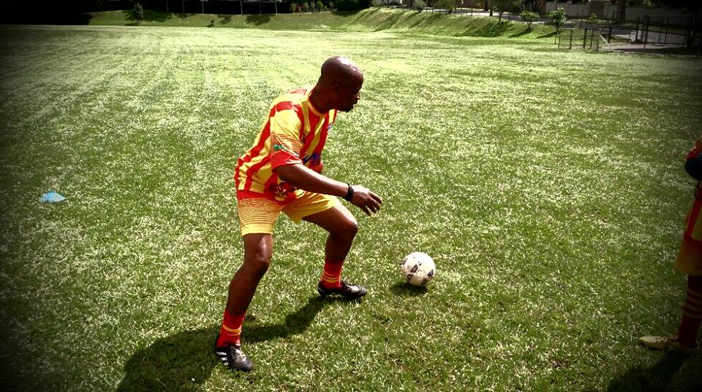
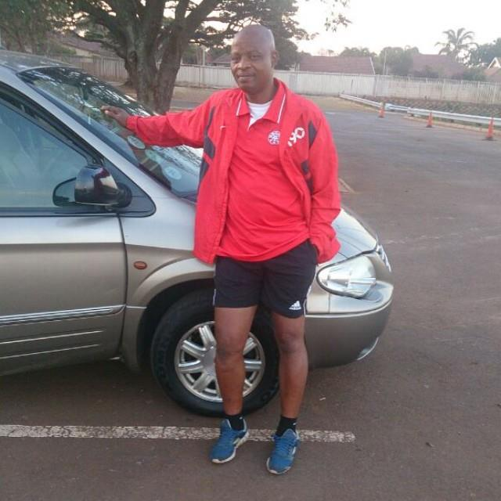


Slide 12
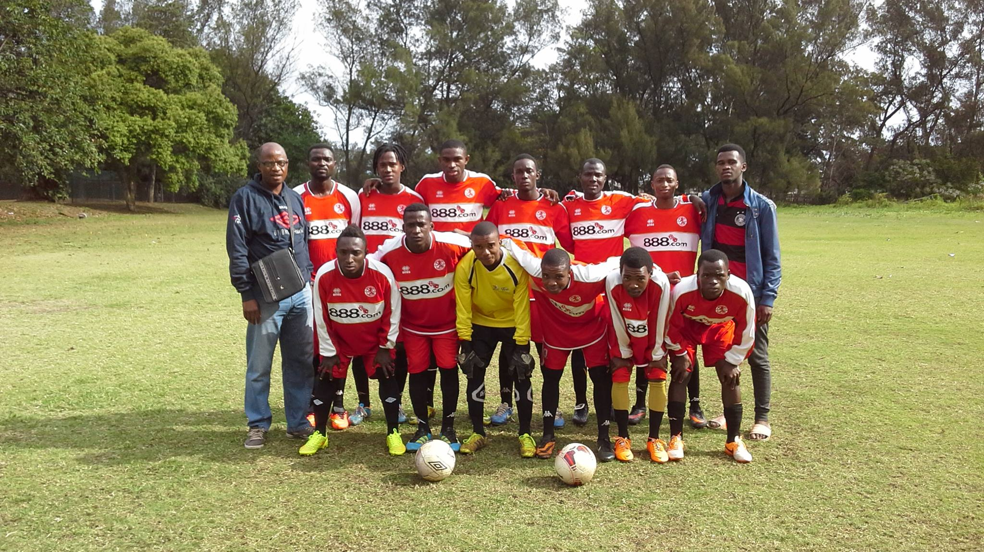

Slide 13
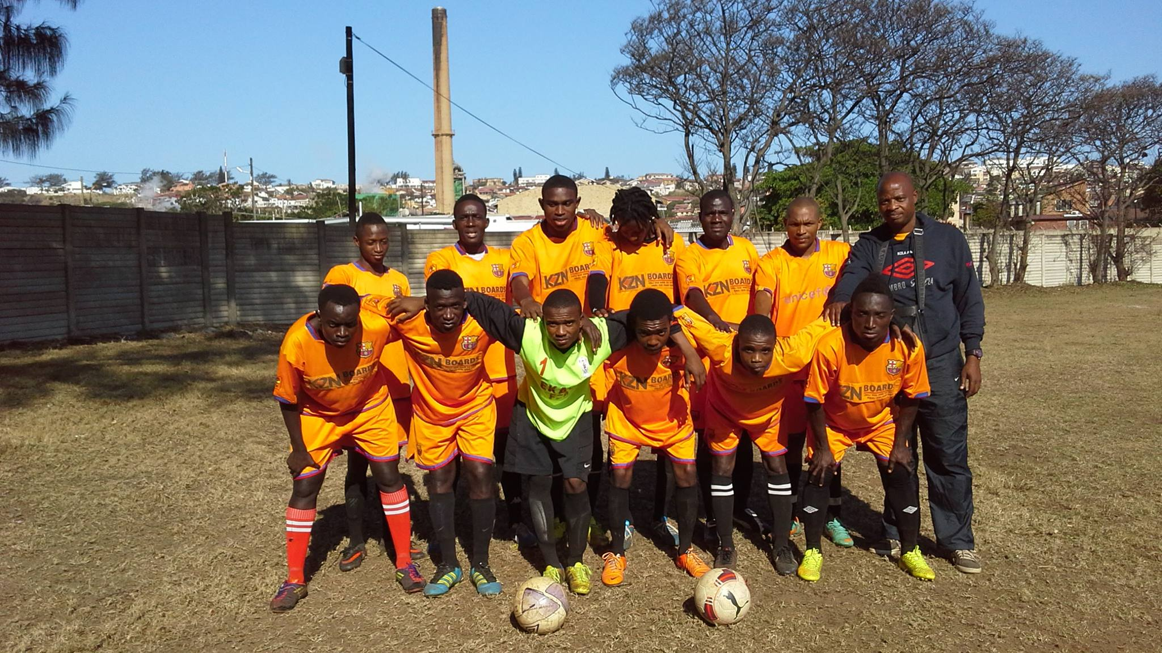

Slide 14


Slide 15


Slide 16
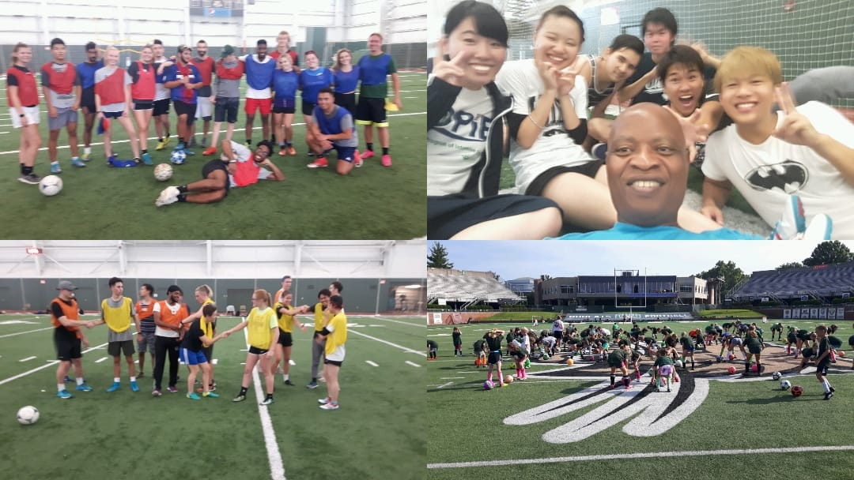

Slide 17


Slide 18
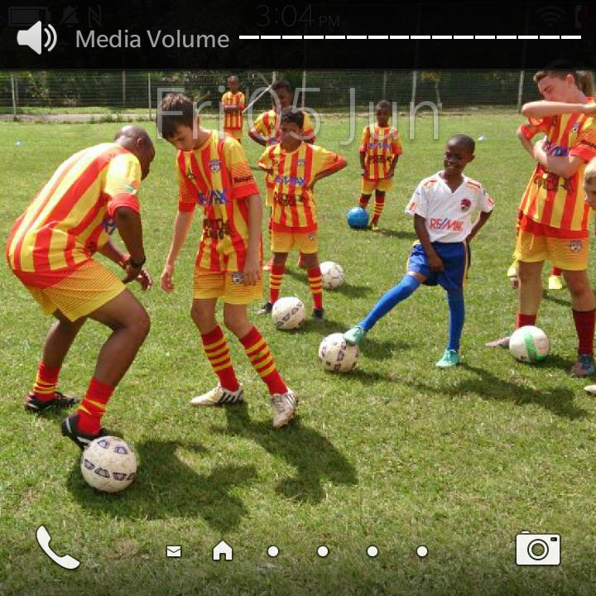

Slide 19


VIEW WEBSITES FOR BETTER UNDERSTANDING
Astra Soccer ACADEMY
https://www.astrasoccer.ca/
https://esyda.org/

Slide 20
Designing Soccer Coaching Programs for Selling

Slide 21
I want to do something like this too!!!
The Coaching Manual
https://app.thecoachingmanual.com/Session/26511?utm_source=TCM+Production&utm_campaign=460827db7f-EMAIL_CAMPAIGN_2020_09_09_12_00_COPY_01&utm_medium=email&utm_term=0_afa0f22b33-460827db7f-83947893&mc_cid=460827db7f&mc_eid=4b65bd0646
Sportplan -Football
https://www.sportplan.net/drills/Football/Conditioned-games/Transition-Game-F602102.jsp?e=36389&utm_source=cm&utm_medium=email&utm_campaign=journeyFootball44

